Slide 1
Sentiment Analysis of Top Engineering Colleges
Harrshavardhann S 221701018
Ganesh K I 221701015

Slide 2
Abstract
Sentiment analysis of top engineering colleges in Tamil Nadu, India, helps evaluate public perception using reviews, social media, and forums.
This study analyzes sentiments from students, alumni, and faculty to identify key factors influencing reputation, such as academics, infrastructure, placements, and campus life. Using natural language processing (NLP) techniques, the analysis classifies opinions as positive, negative, or neutral.
The findings provide insights for prospective students, institutions, and policymakers to improve educational standards and address concerns.
This research highlights emerging trends in public perception, aiding better decision-making for stakeholders in the higher education sector.

Slide 3
Introduction
Sentiment analysis is a powerful technique used to assess public opinion about top engineering colleges in Tamil Nadu, India. With the rise of online reviews, social media discussions, and student feedback, understanding sentiments helps institutions and stakeholders make informed decisions.
This study leverages Natural Language Processing (NLP) to analyze opinions on factors like academics, placements, infrastructure, and campus life.
By classifying sentiments as positive, negative, or neutral, it provides insights into the overall perception of these institutions.
The findings can help prospective students choose the right college and assist colleges in improving their services.
This research highlights key trends in educational sentiment, aiding continuous development in higher education.

Slide 4
Objective
Analyze Public Perception
To assess the opinions and sentiments of students, alumni, and faculty about top engineering colleges in
Tamil Nadu.
Evaluate Key Factors
To identify critical aspects such as academics, infrastructure, placements, and campus life influencing college reputation.
Utilize NLP Techniques
To employ Natural Language Processing (NLP) for classifying sentiments into positive, negative, or neutral categories.
Aid Prospective Students
To provide data-driven insights that help students make informed decisions when selecting a college.
Support Institutional Improvement
To help colleges understand public feedback and enhance their educational and administrative standards.
Identify Trends in Education
To recognize emerging trends in student expectations and satisfaction for continuous improvement in higher education.

Slide 5
Literature Survey
Several studies have explored sentiment analysis in higher education to understand student perceptions of engineering colleges in Tamil Nadu.
Research has utilized Natural Language Processing (NLP) and machine learning techniques to classify sentiments from reviews, social media, and discussion forums.
Previous works highlight factors like faculty quality, placements, and infrastructure as key determinants of student satisfaction.
However, challenges such as biased data, limited regional language processing, and sarcasm detection impact accuracy.
Most studies focus on structured datasets, overlooking real-time social media insights.
Addressing these drawbacks can improve sentiment analysis models for better decision-making in the education sector.

Slide 6
Methodology for Sentiment Analysis
The methodology for sentiment analysis of top engineering colleges in Tamil
Nadu involves data collection from online reviews, social media, and forums.
Preprocessing techniques such as tokenization, stop-word removal, and
stemming are applied to clean the data.
Machine learning and Natural Language Processing (NLP) models, including
Naïve Bayes, SVM, and deep learning, classify sentiments as positive,
negative, or neutral.
Sentiment scores and trend analysis help evaluate public perception based on key factors like academics, placements, and infrastructure.
However, challenges include handling regional language variations, sarcasm, and fake reviews, which can affect accuracy. Improving multilingual NLP models and refining sentiment classification techniques can enhance analysis reliability.

Slide 7

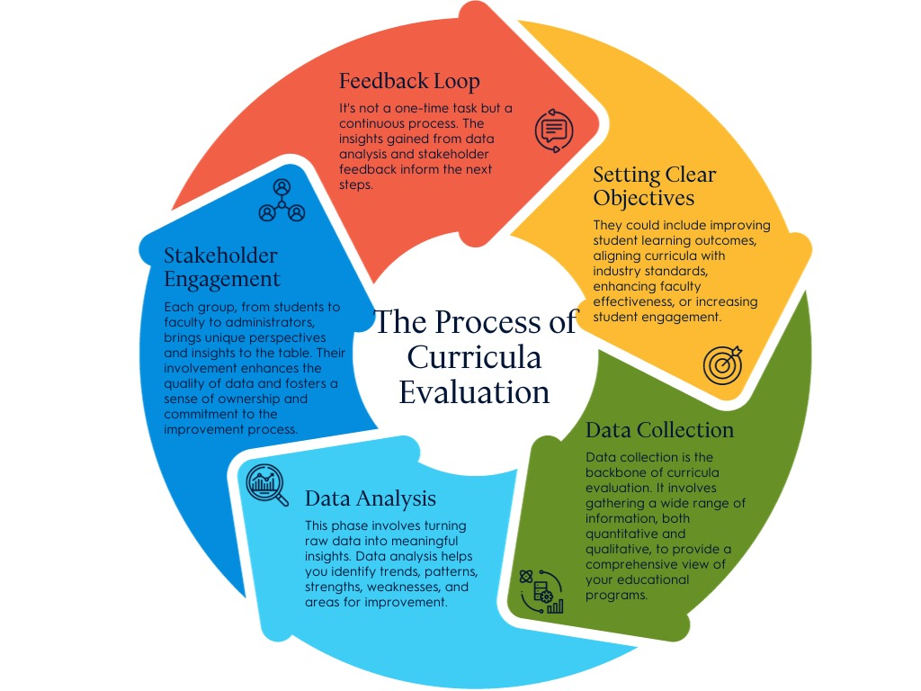
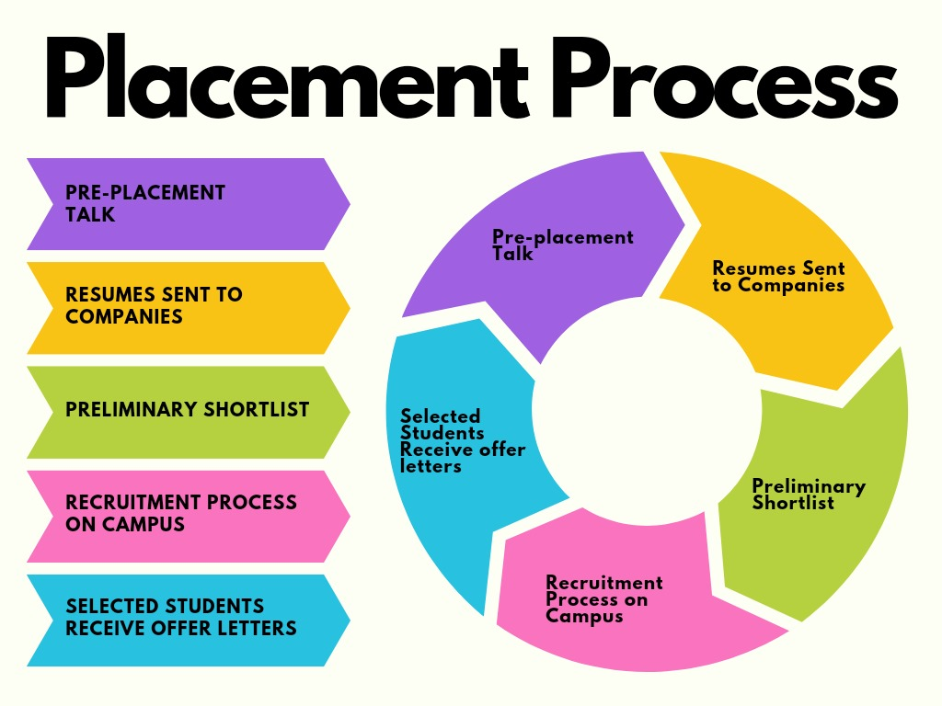

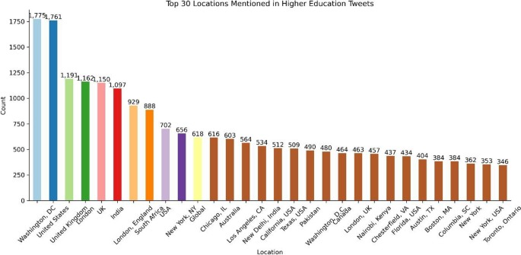
Sentiment Analysis Use Cases
1. Student Feedback on Campus Facilities
2. Course Curriculum Evaluation
3. Placement Program Analysis
4.Faculty and Teaching Quality
5. Competitor Analysis

Slide 8


